Slide 1
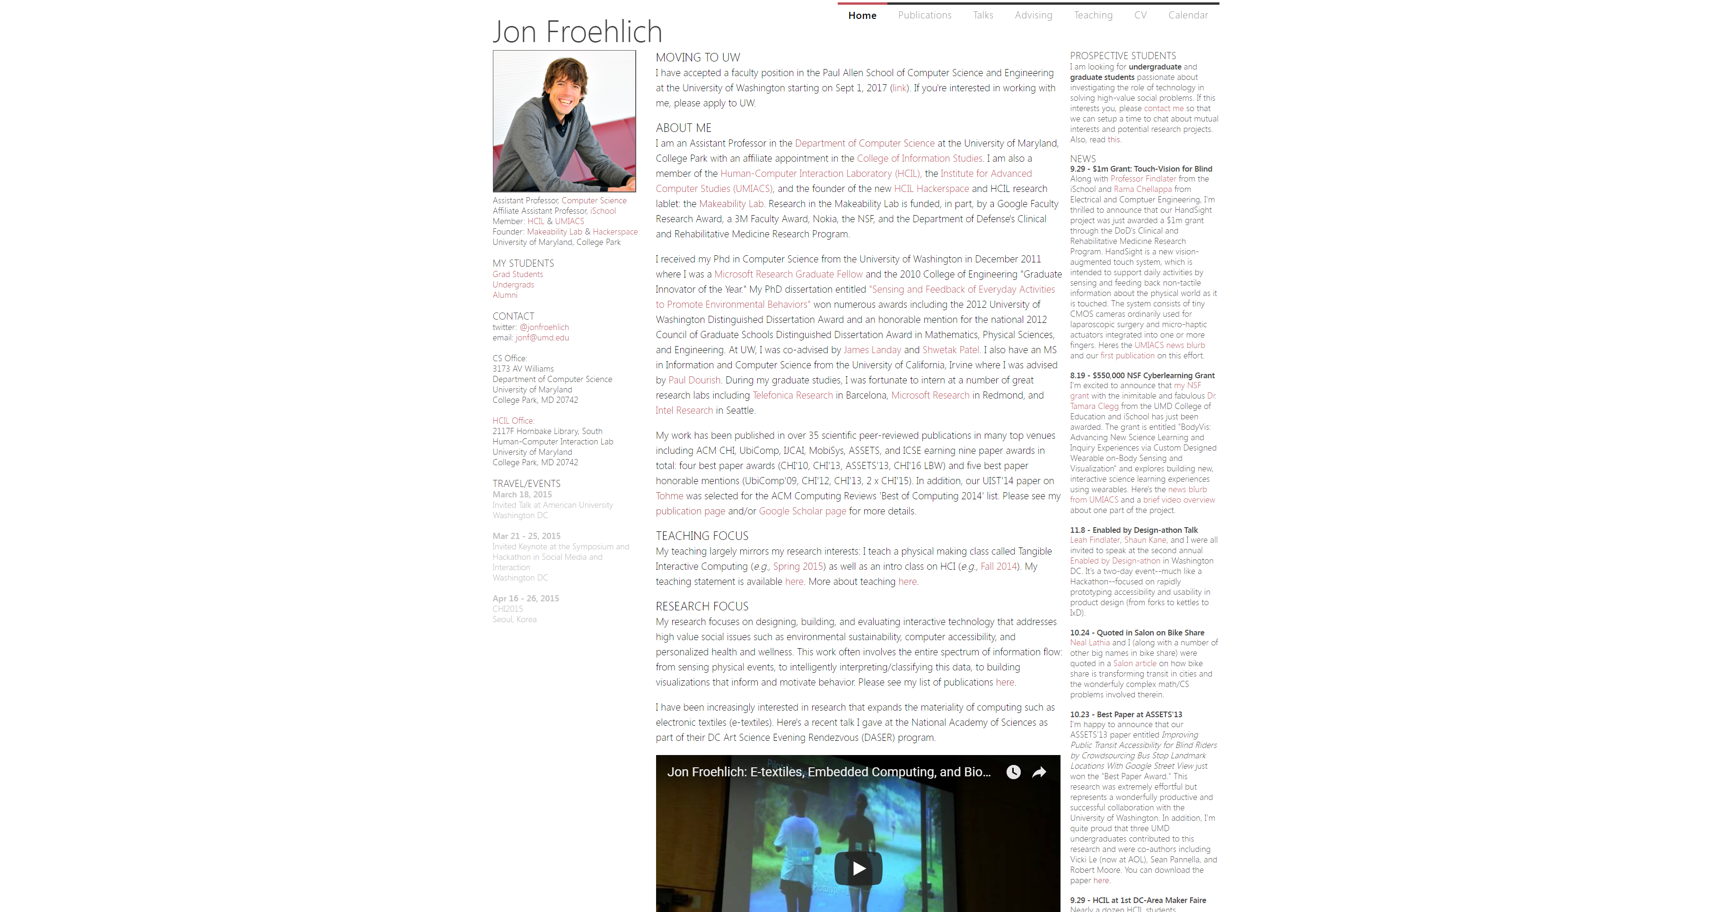

Slide 2


Slide 3
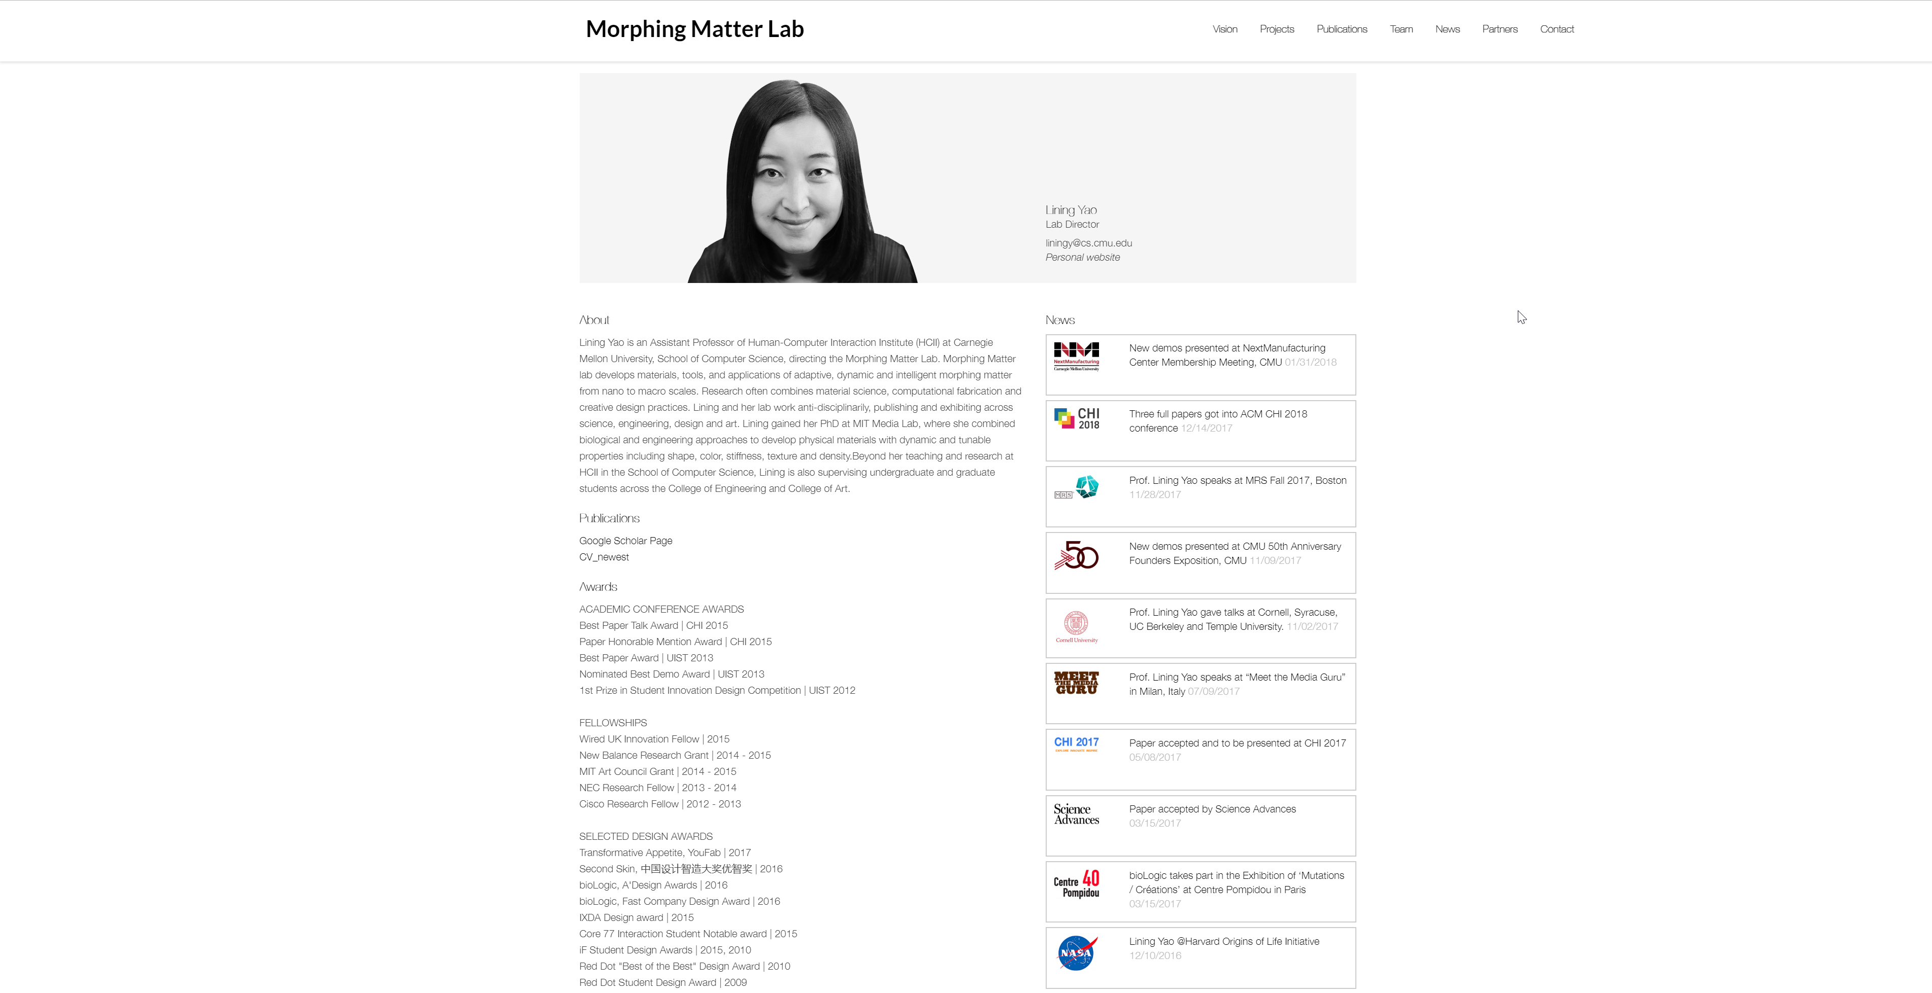
Notes:
http://morphingmatter.cs.cmu.edu/lining-yao/

Slide 4
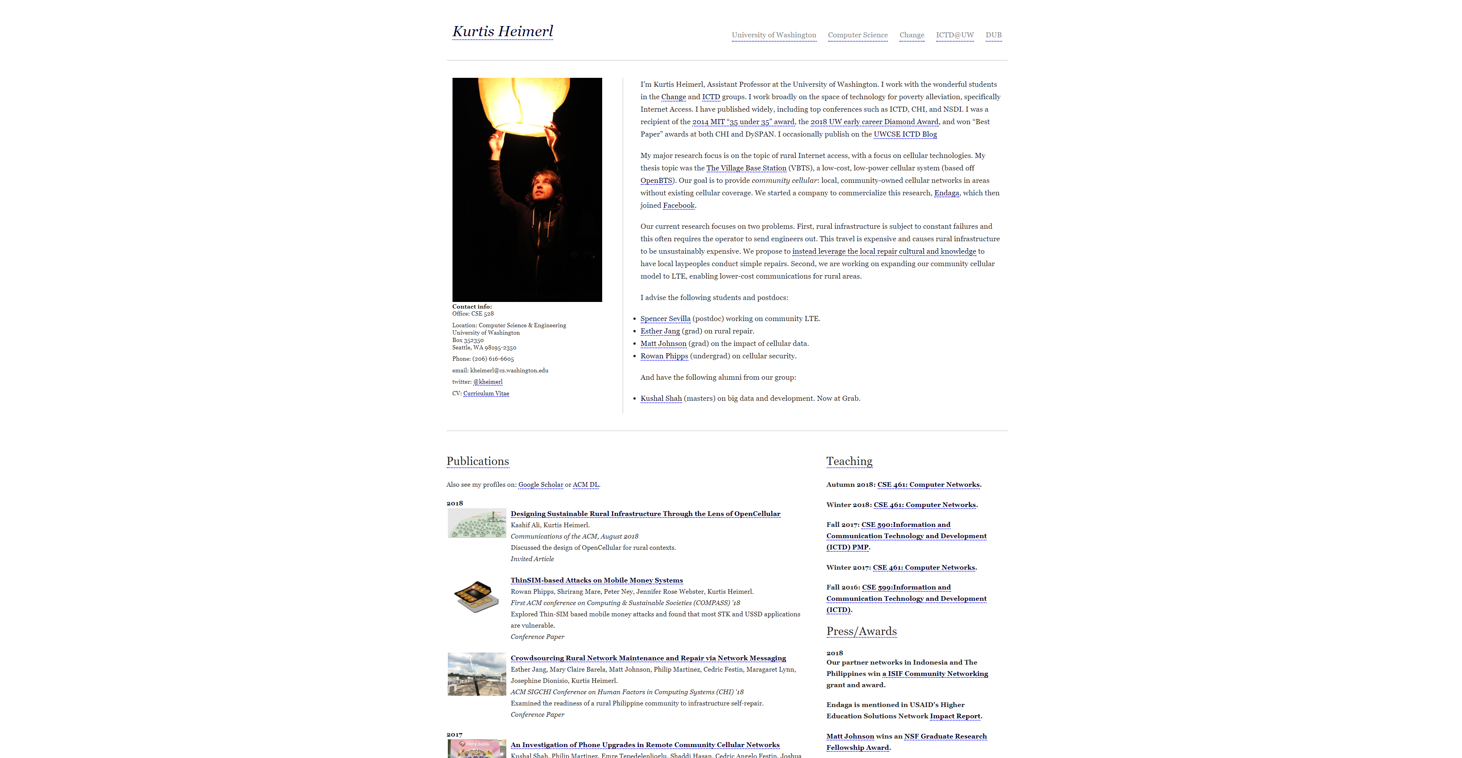

Slide 5
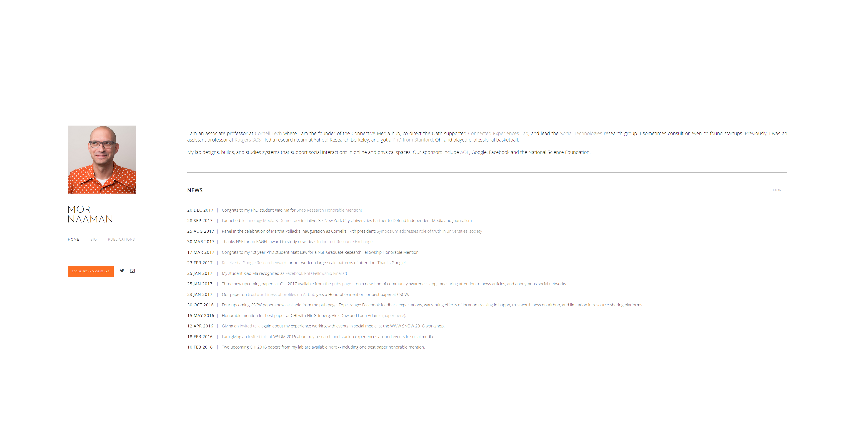
Notes:
https://people.jacobs.cornell.edu/mor/

Slide 6
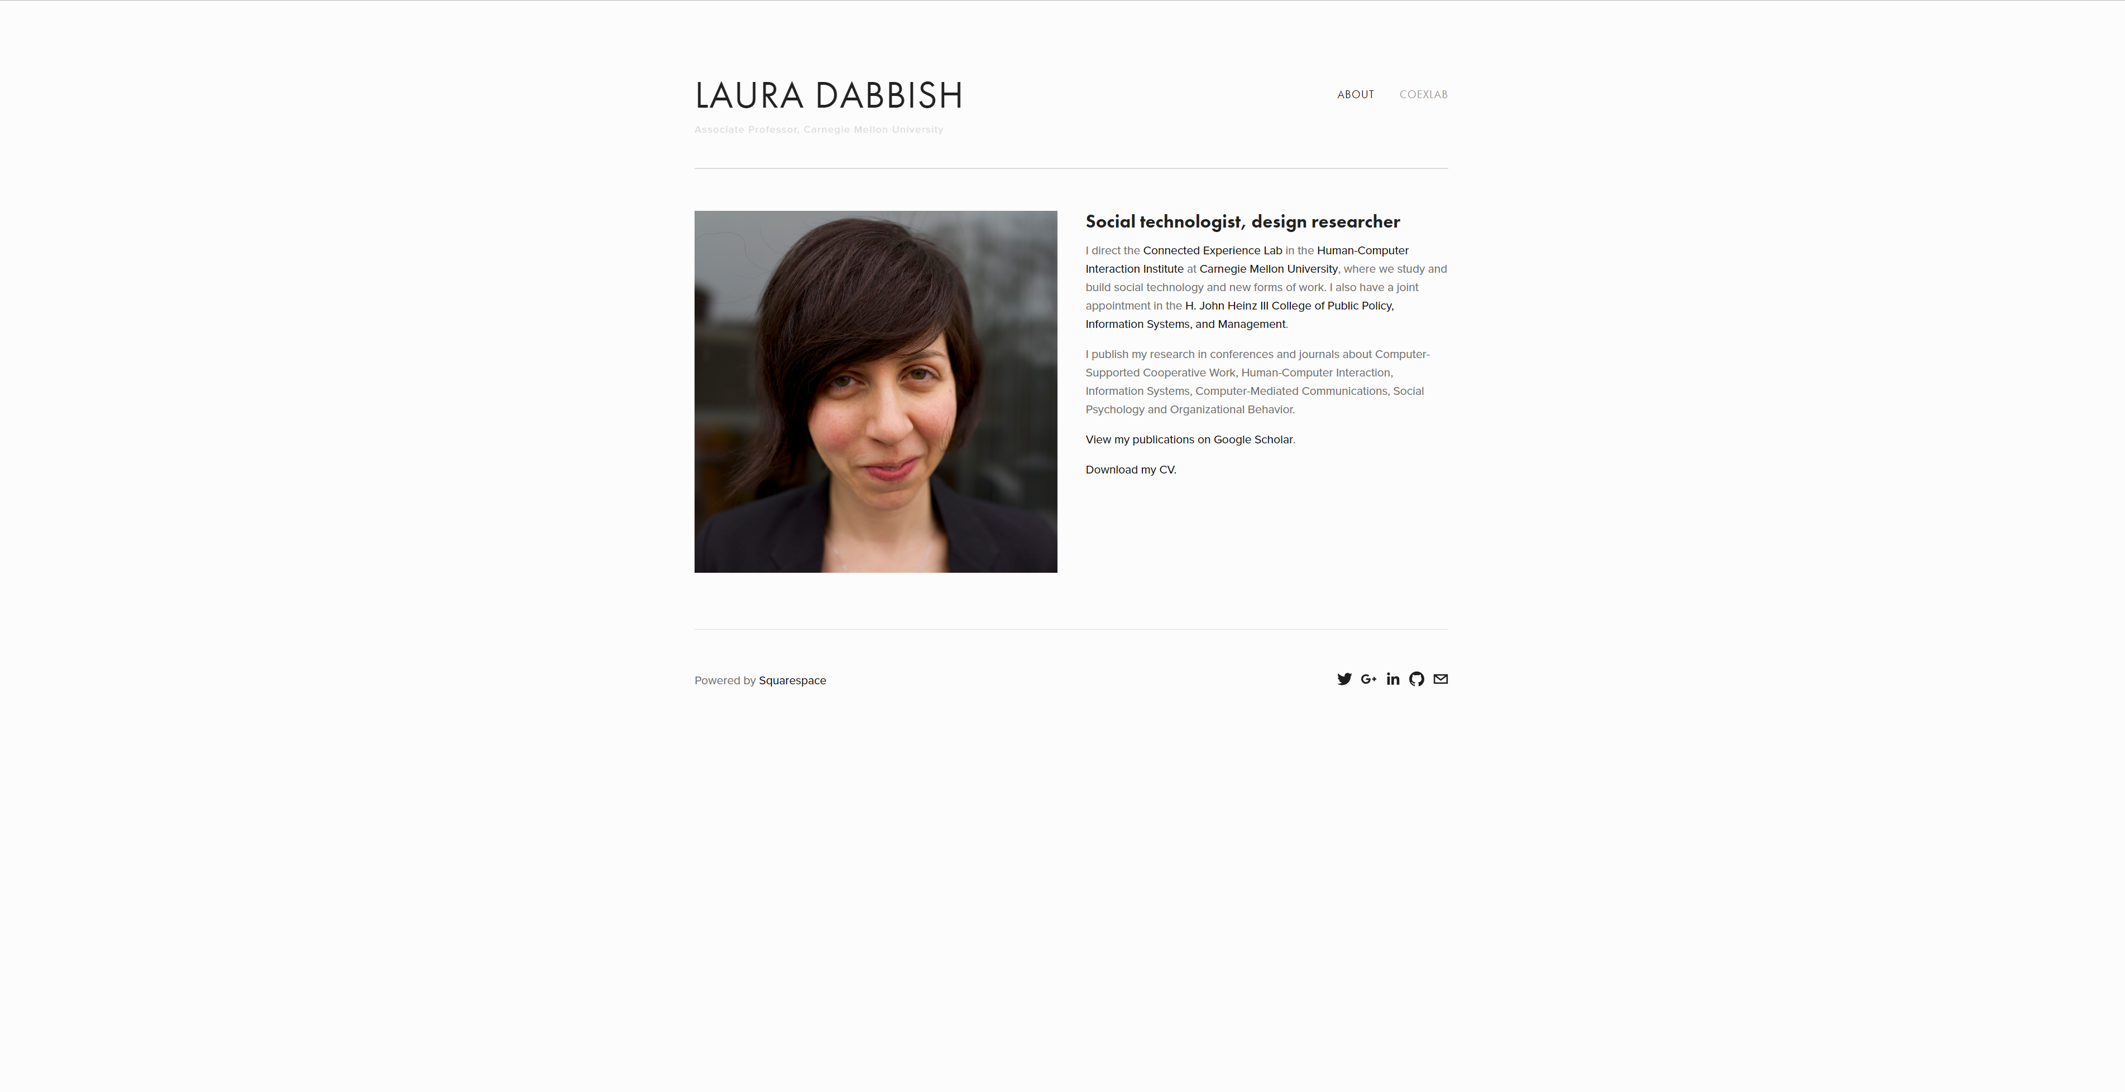
Notes:
http://www.lauradabbish.com/

Slide 7
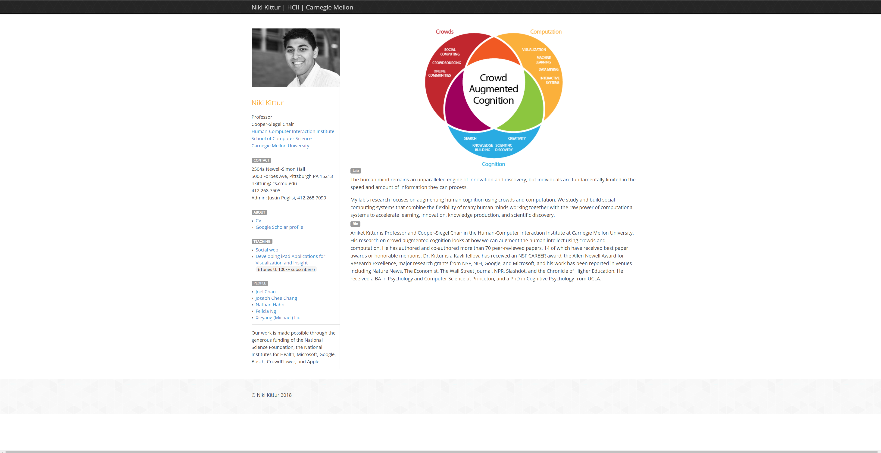
Notes:
http://kittur.org/

Slide 8
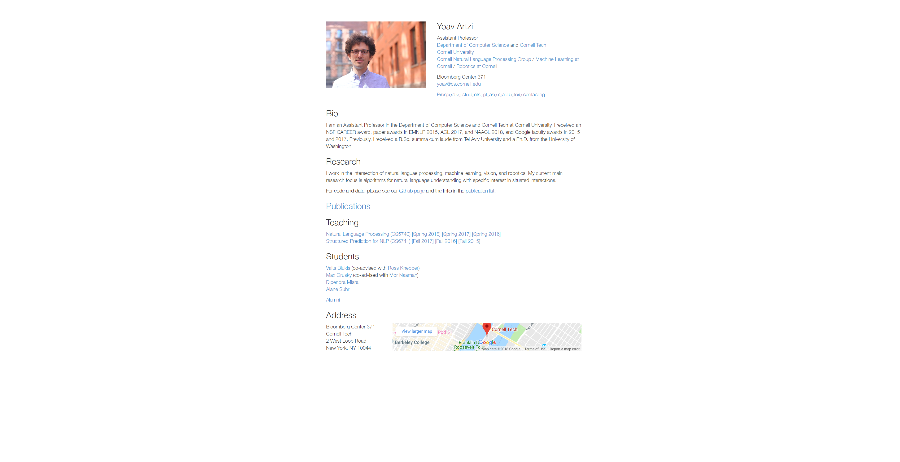

Slide 9
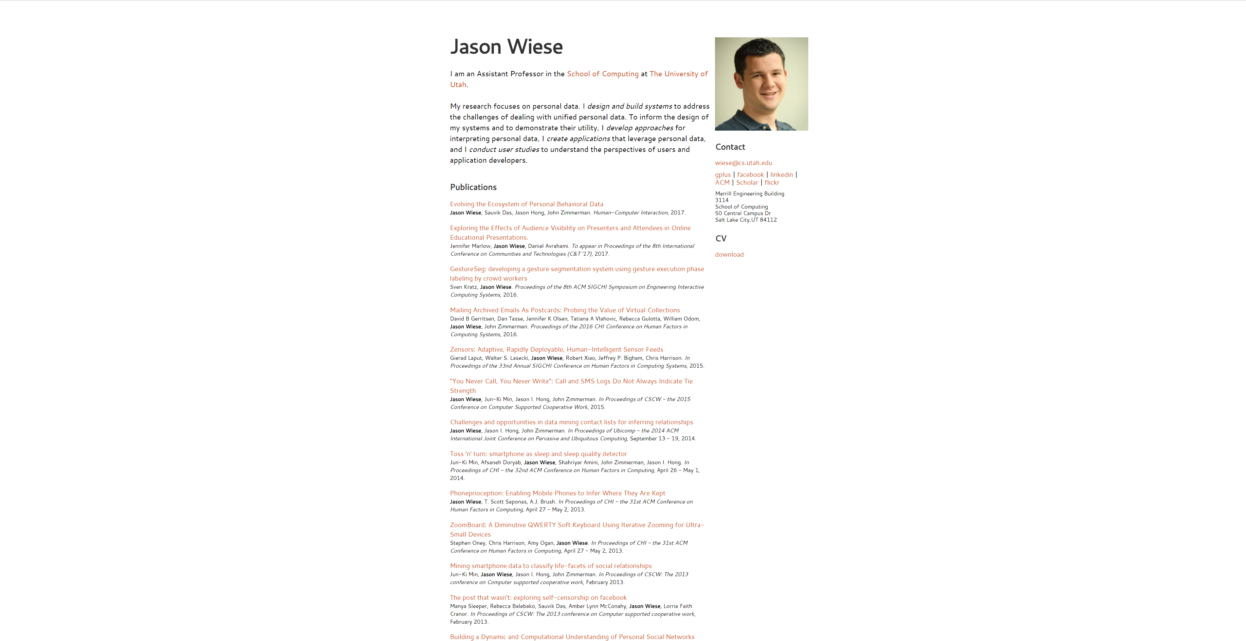

Slide 10
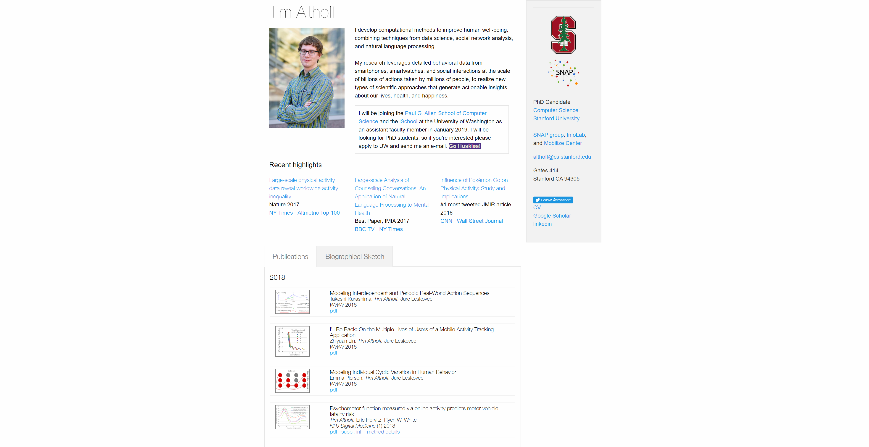
Notes:
http://timalthoff.de/

Slide 11
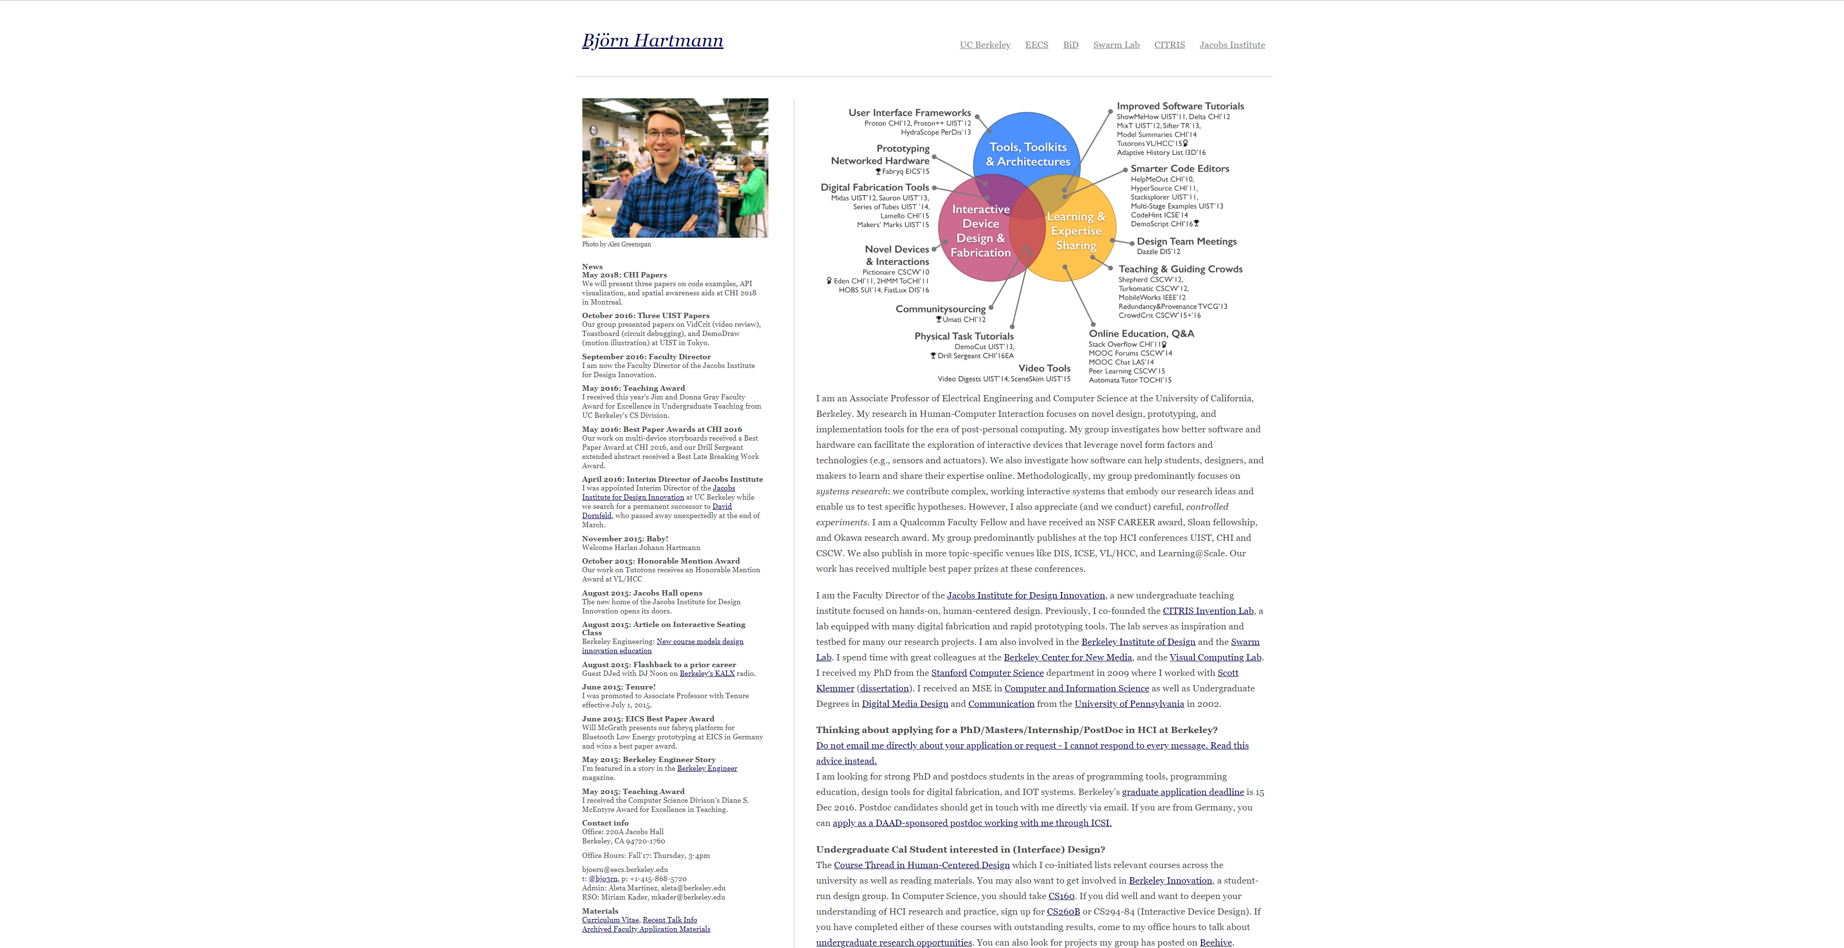

Slide 12
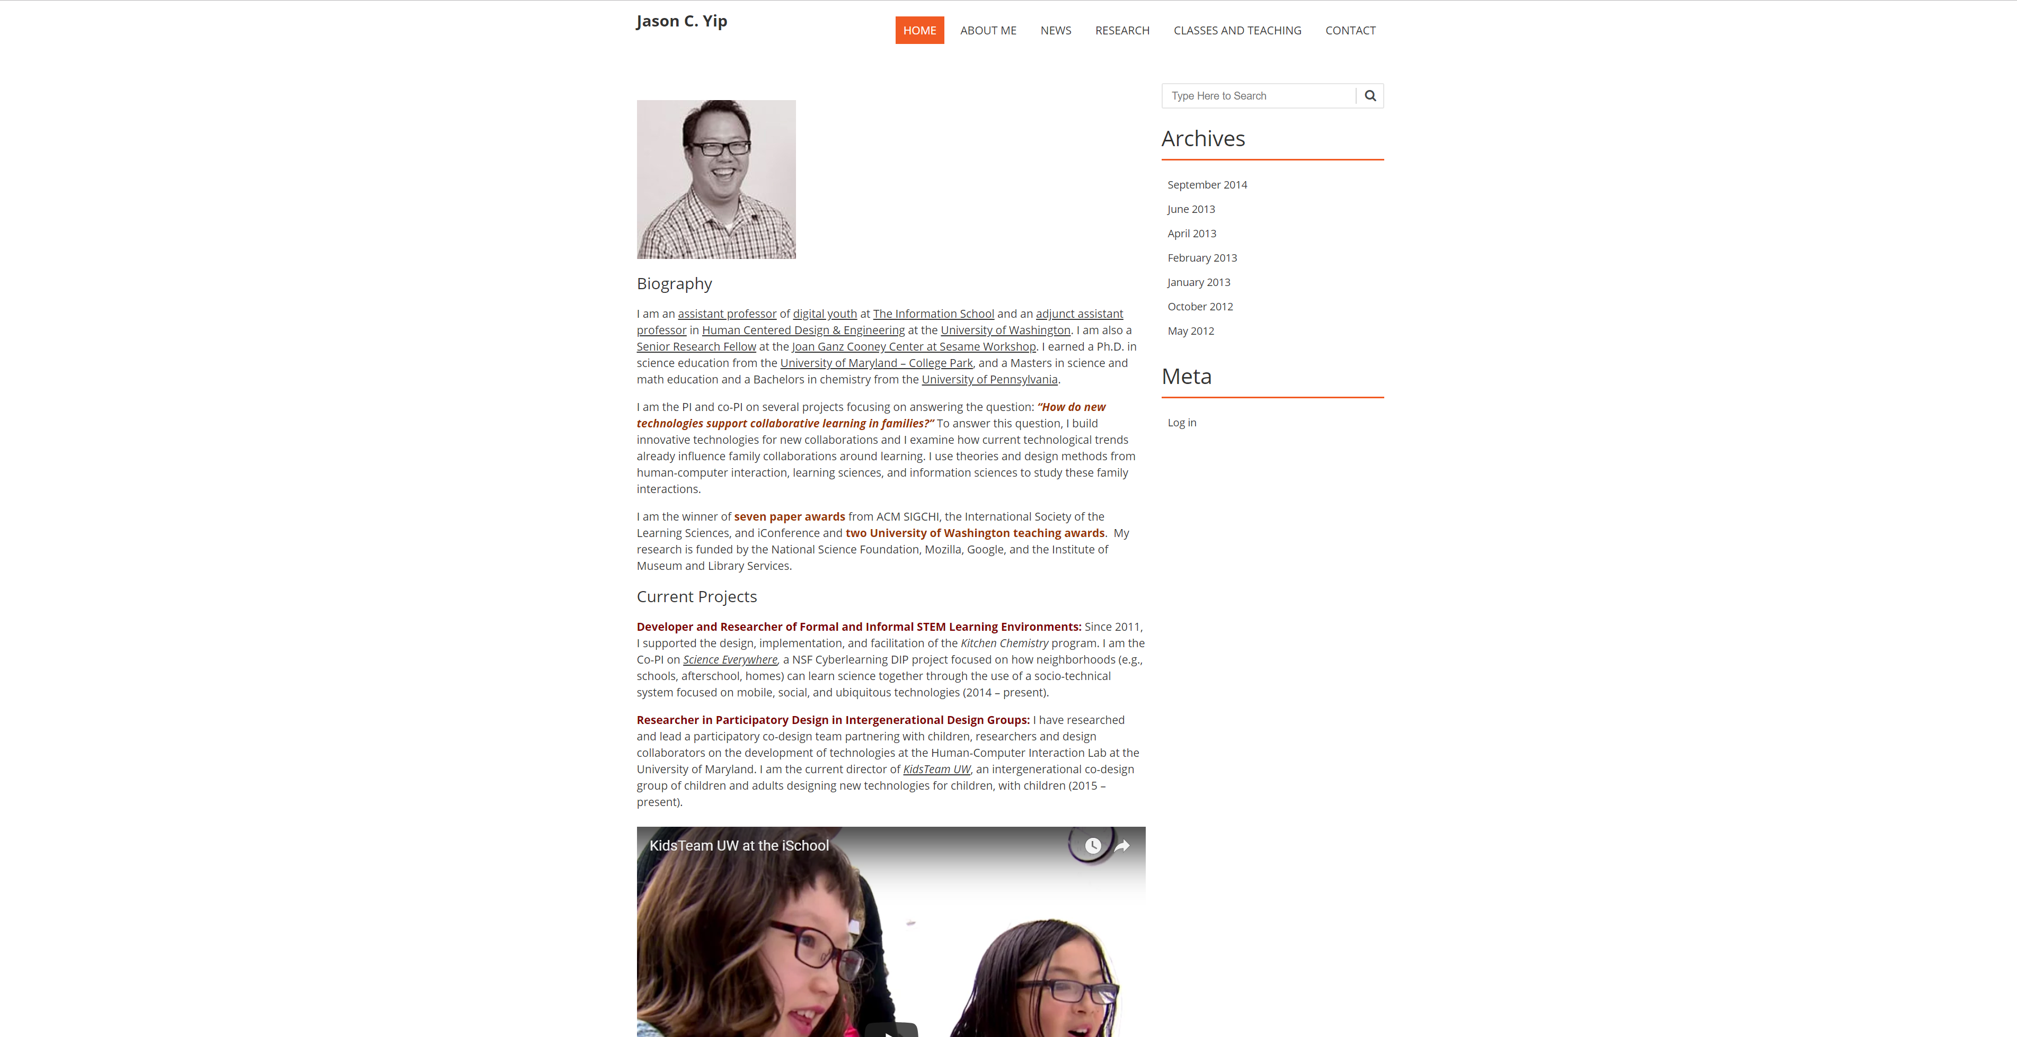

Slide 13
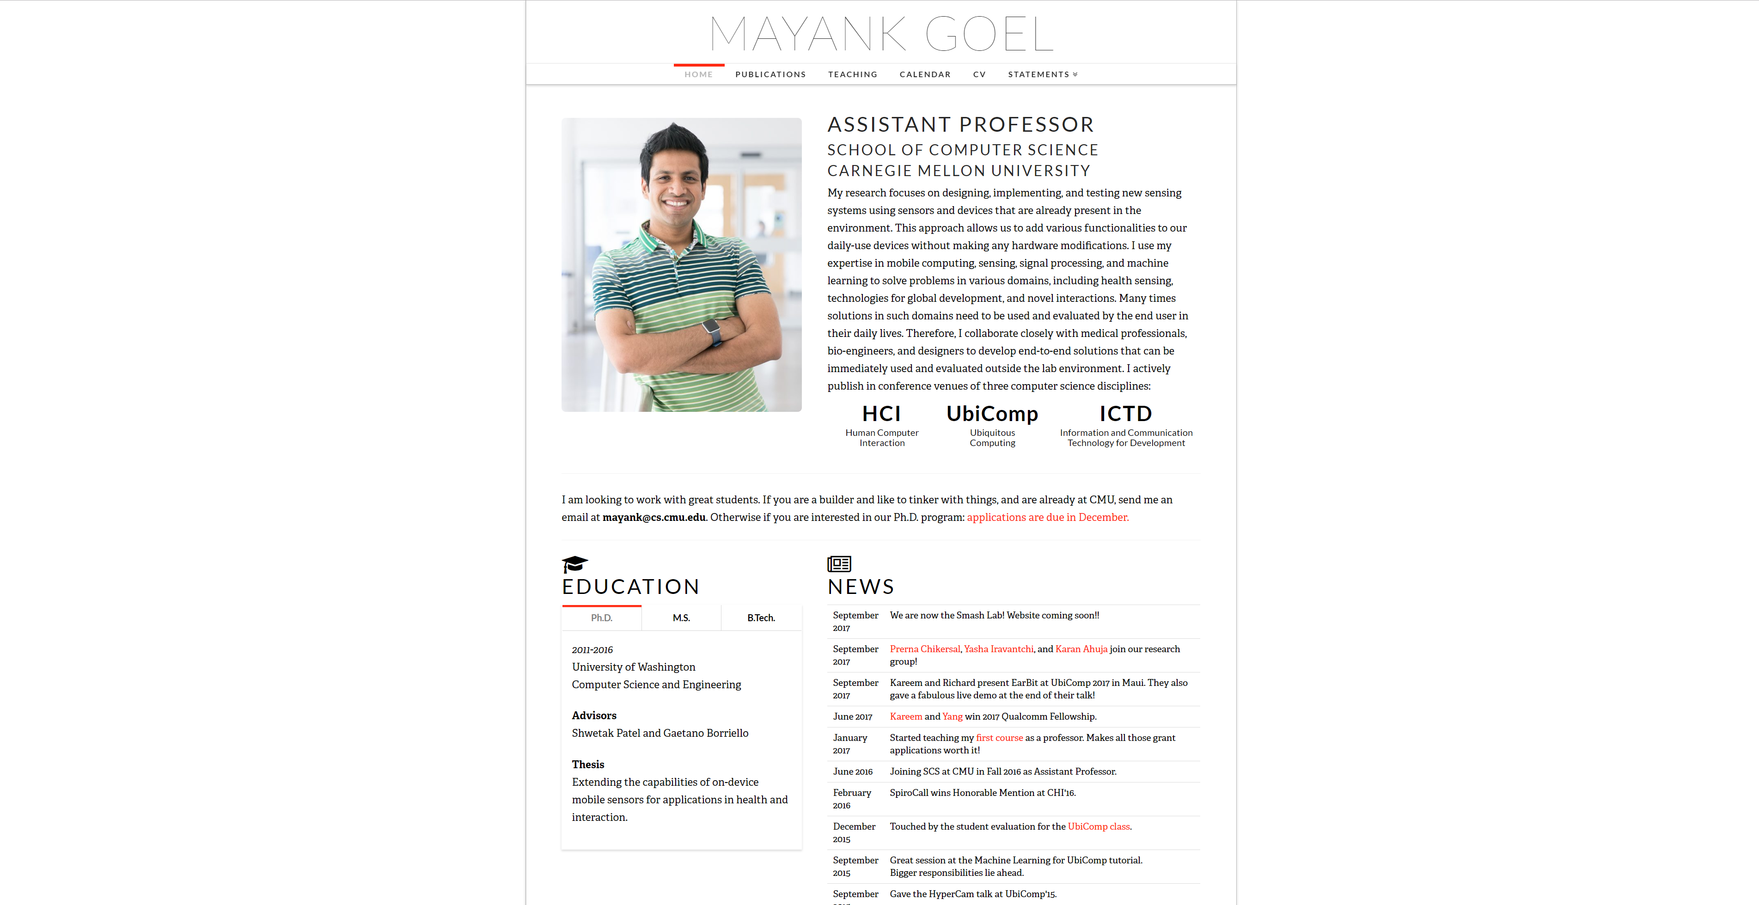
Notes:
http://www.mayankgoel.courses/

Slide 14
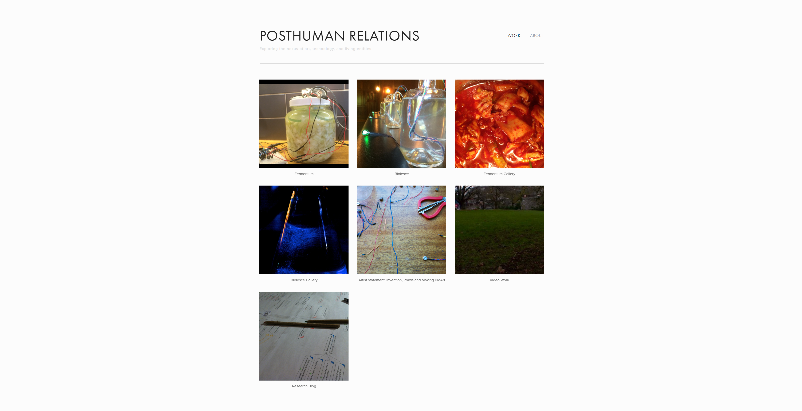
Notes:
Tyler Fox: http://www.tylersfox.com/

Slide 15
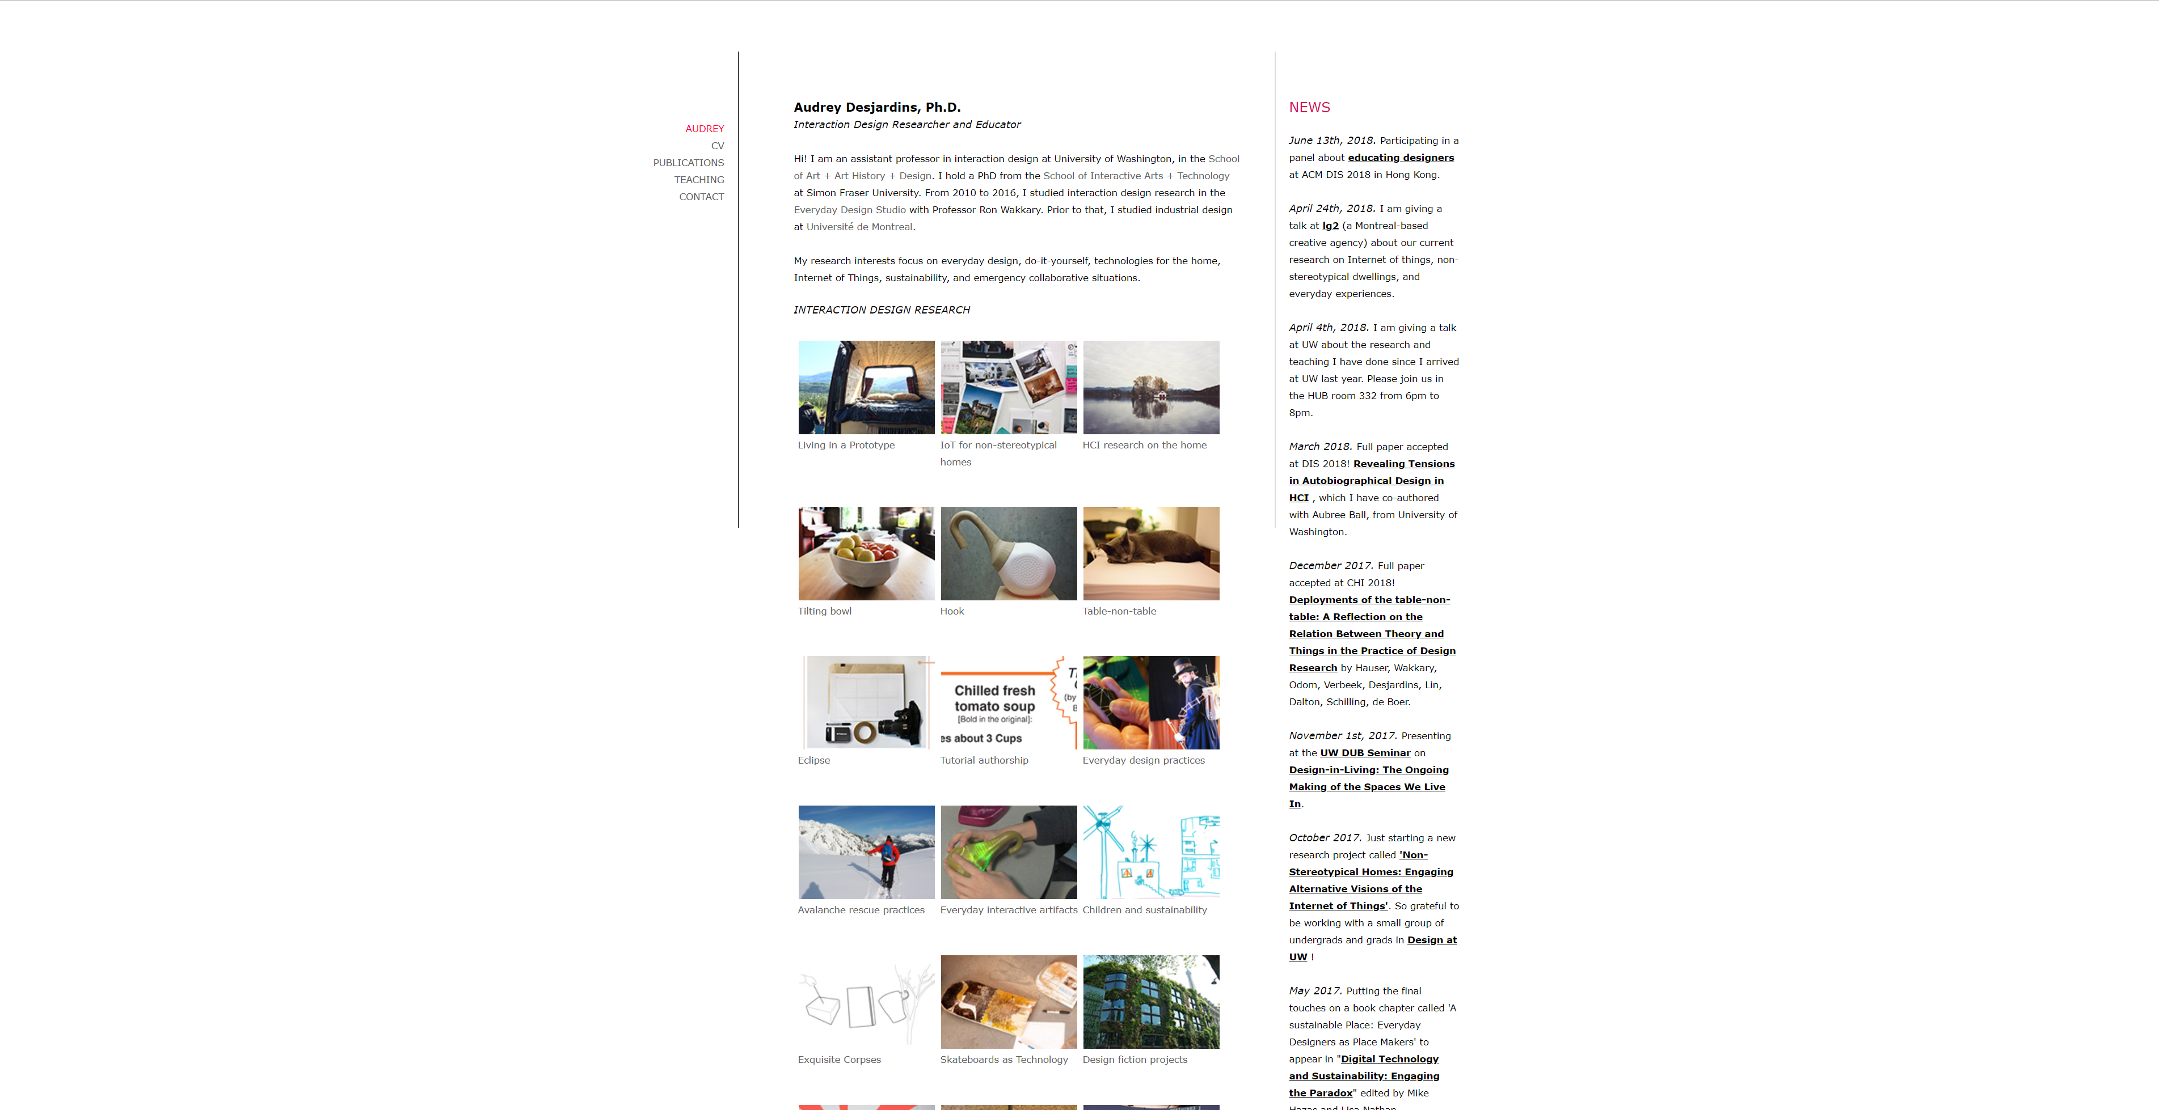

Slide 16
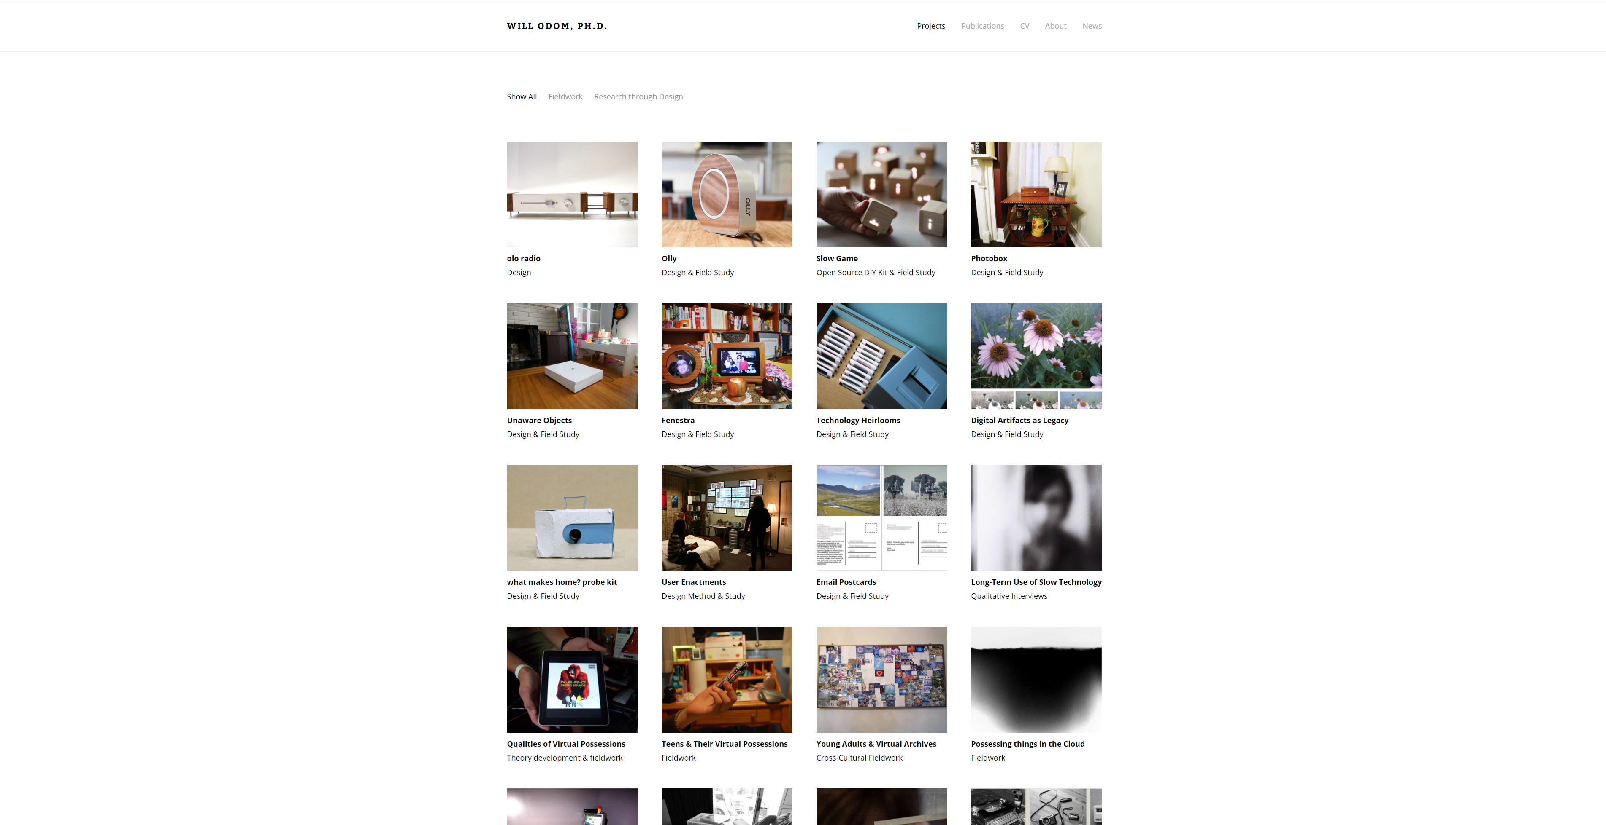
Notes:
http://willodom.com/

Slide 17
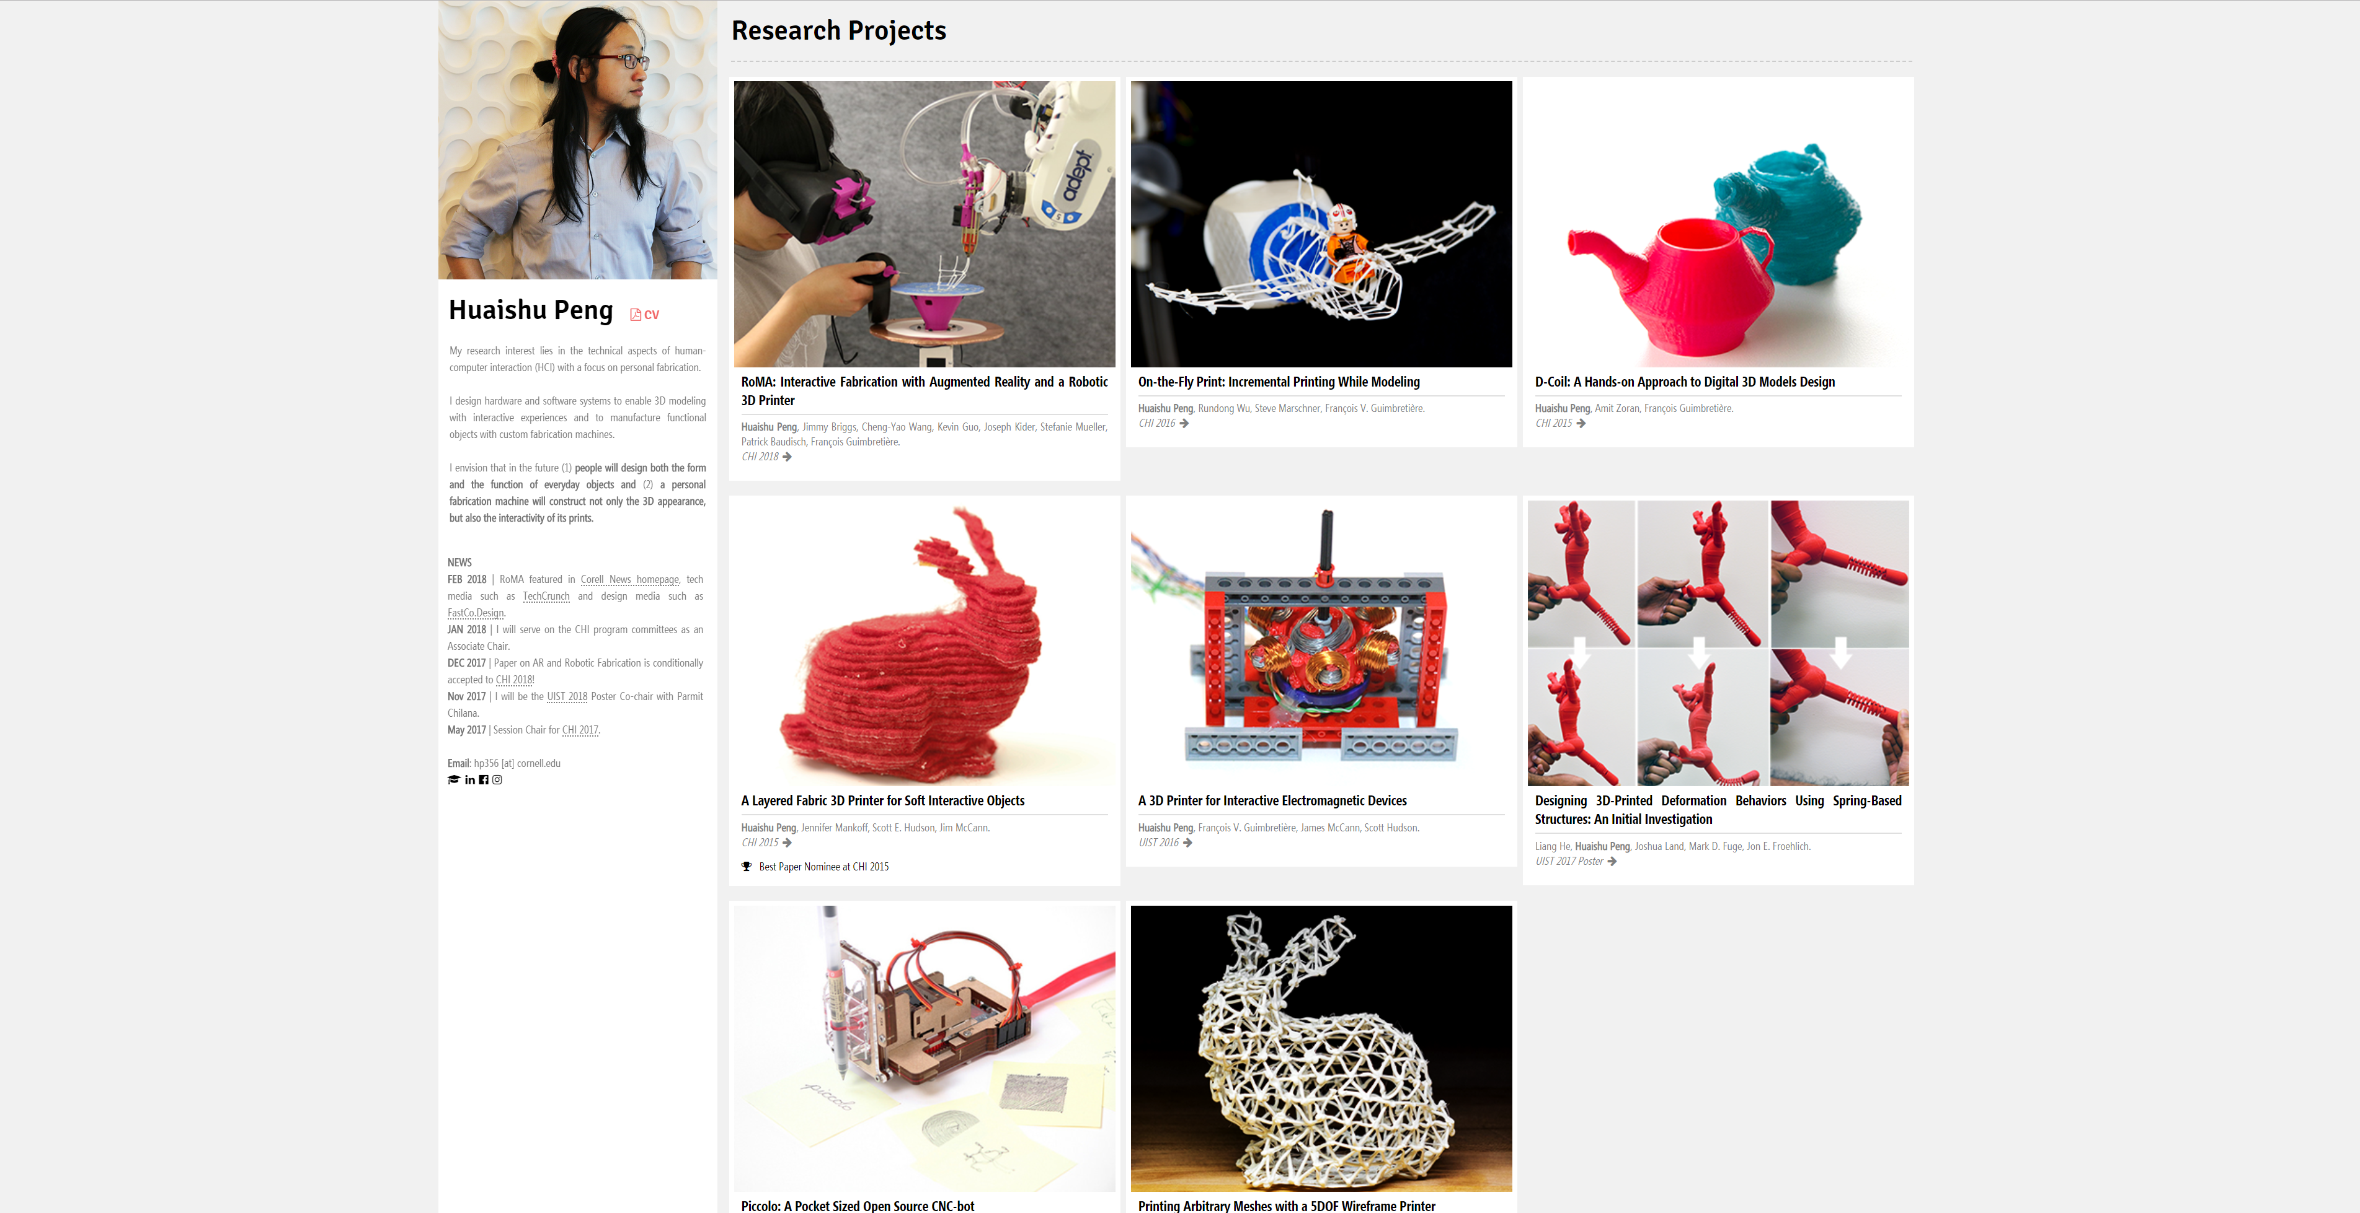

Slide 18
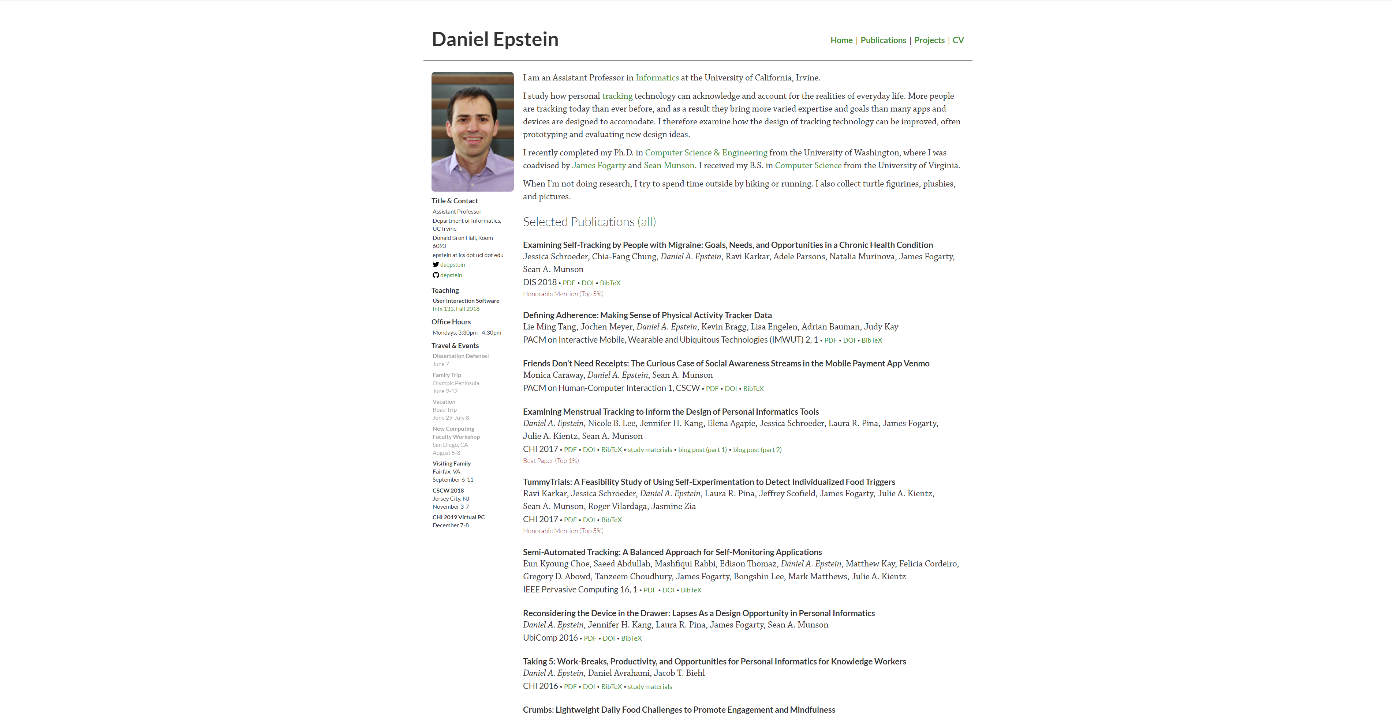

Slide 19
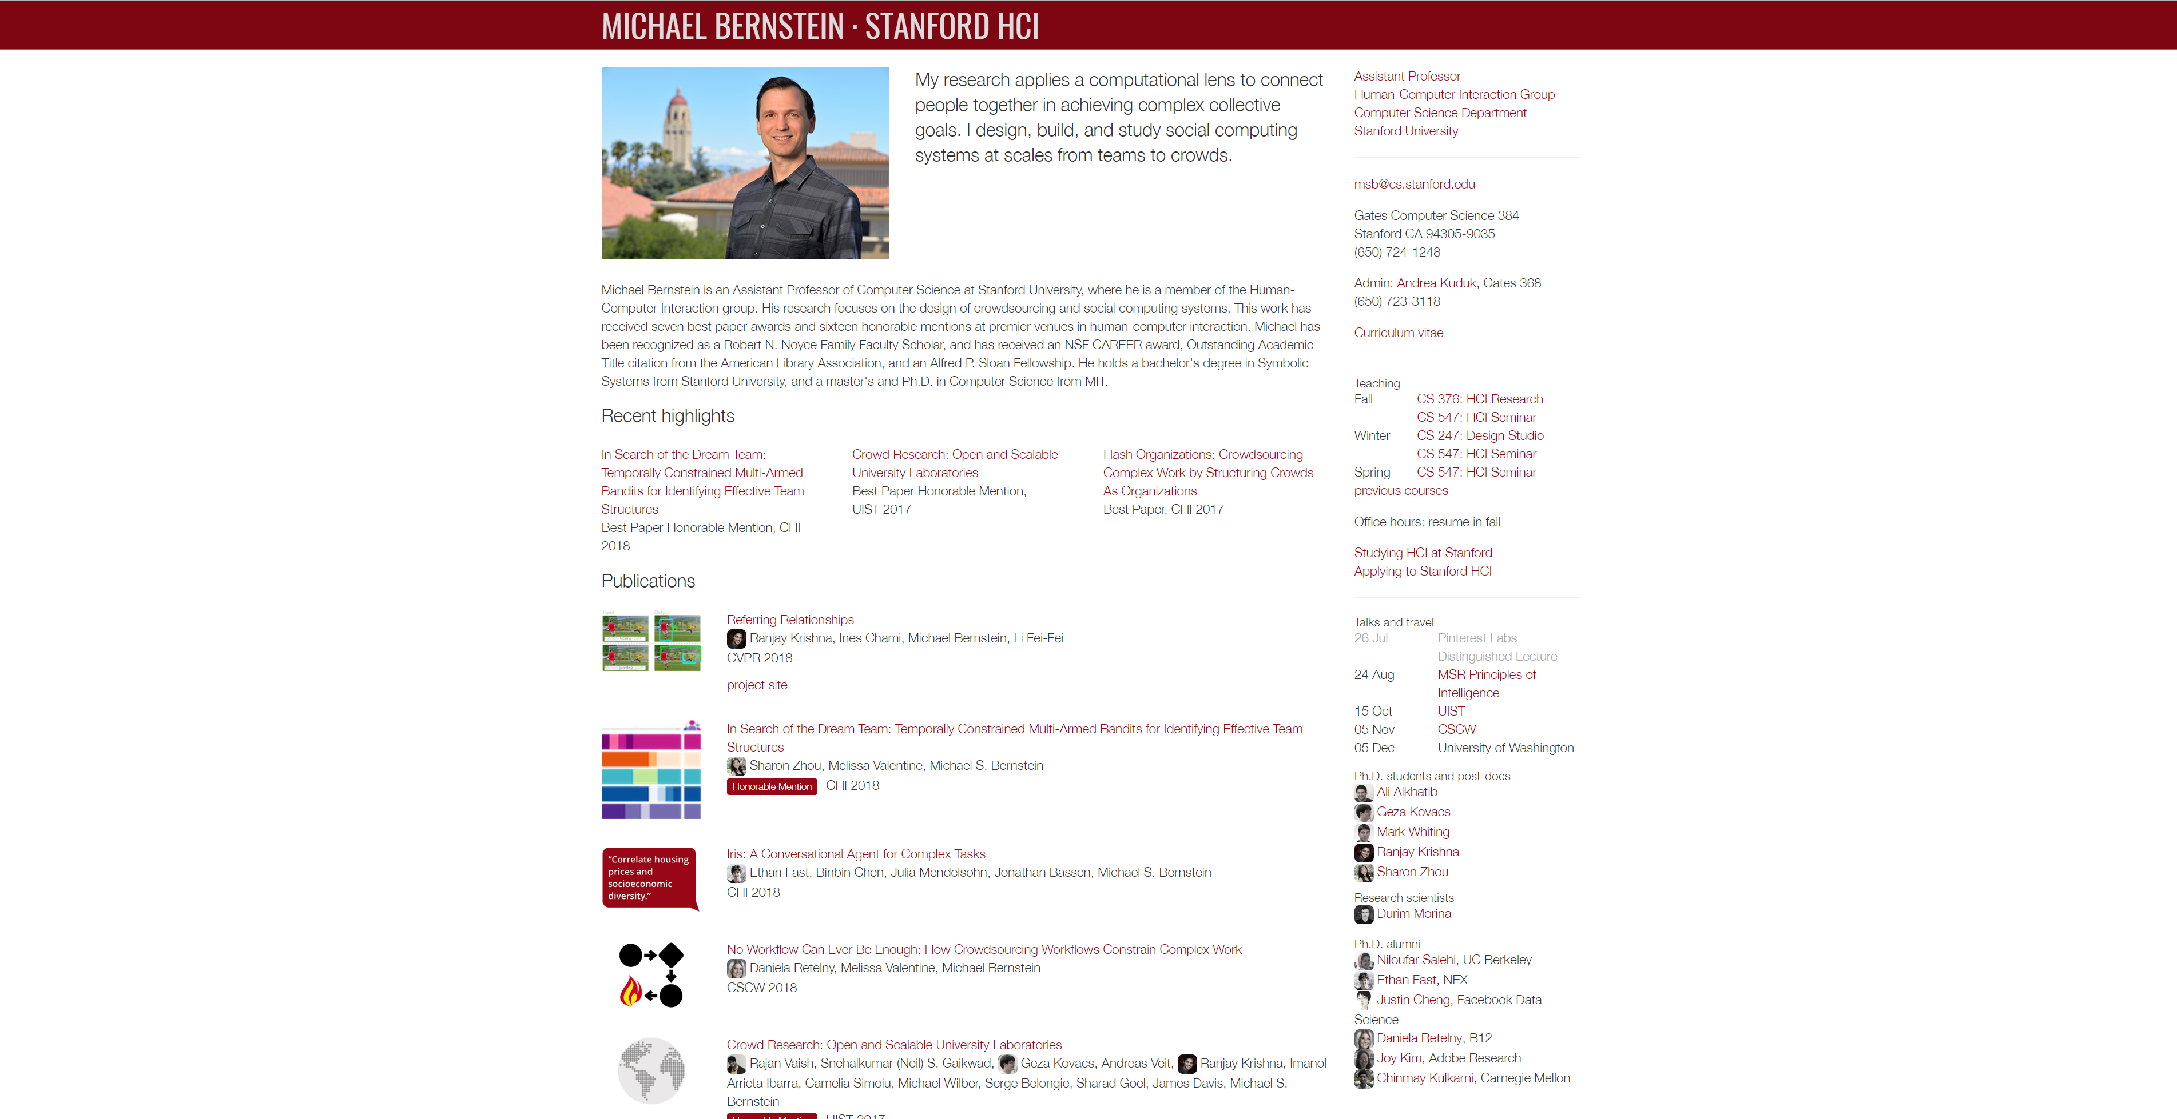
Notes:
http://hci.stanford.edu/msb/

Slide 20
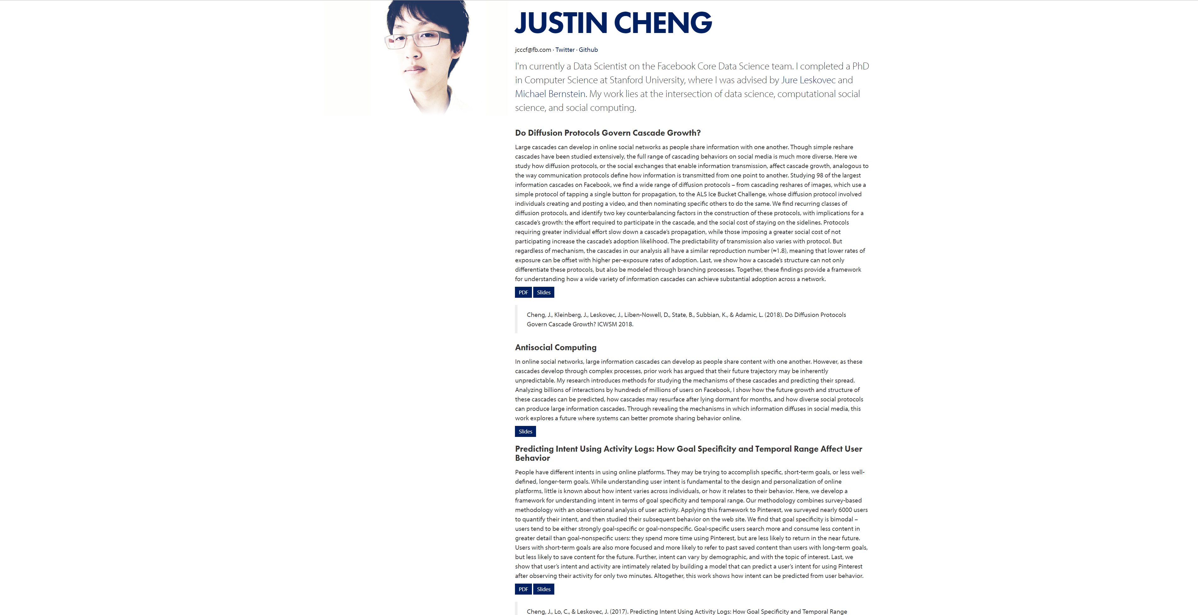
Notes:
https://www.clr3.com/

Slide 21
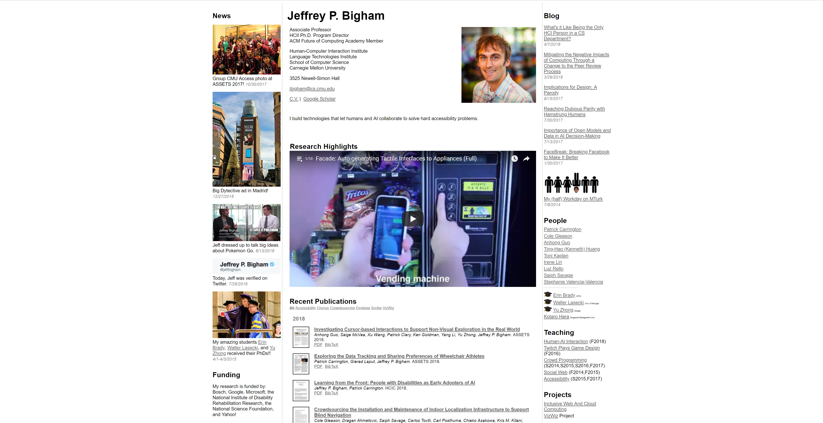
Notes:
https://www.cs.cmu.edu/~jbigham/

Slide 22
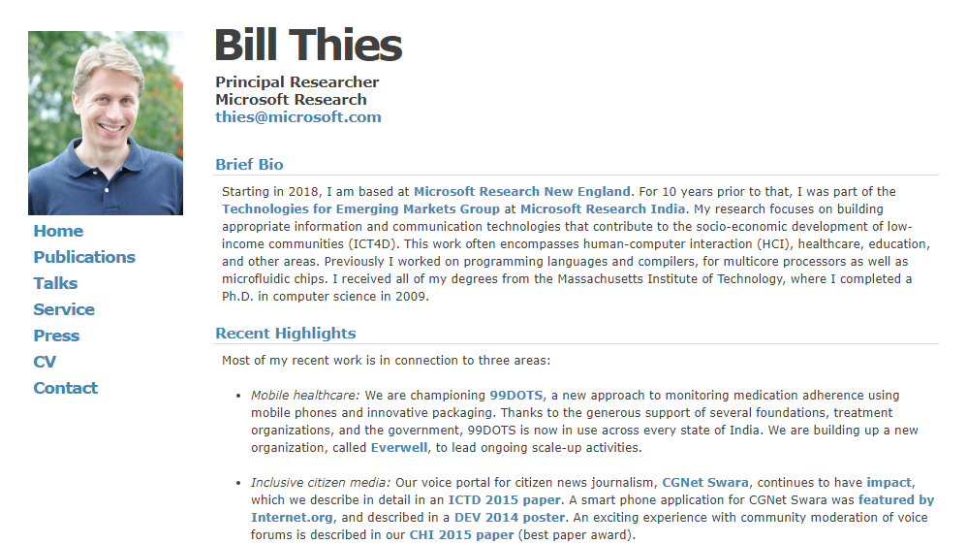

Slide 23
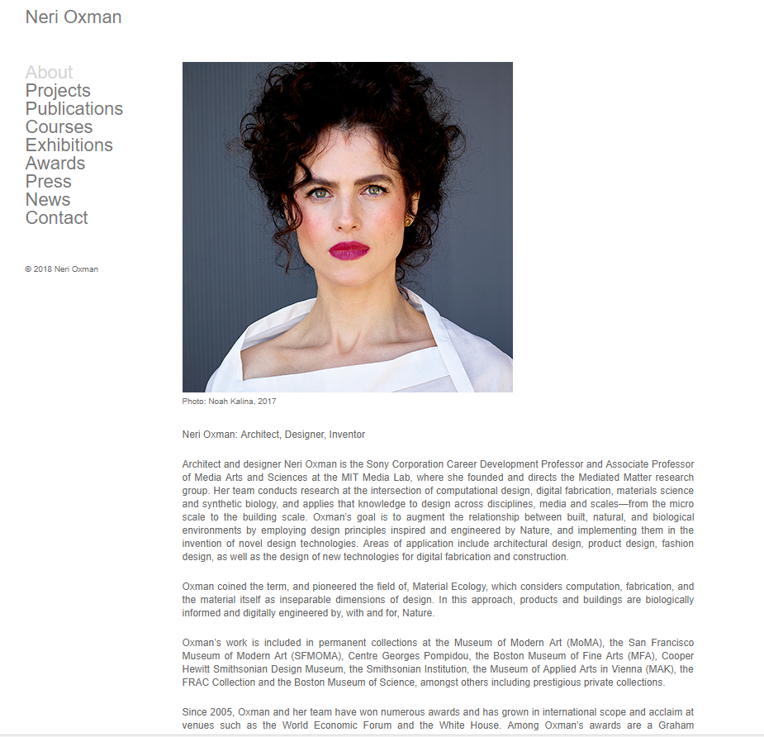

Slide 24
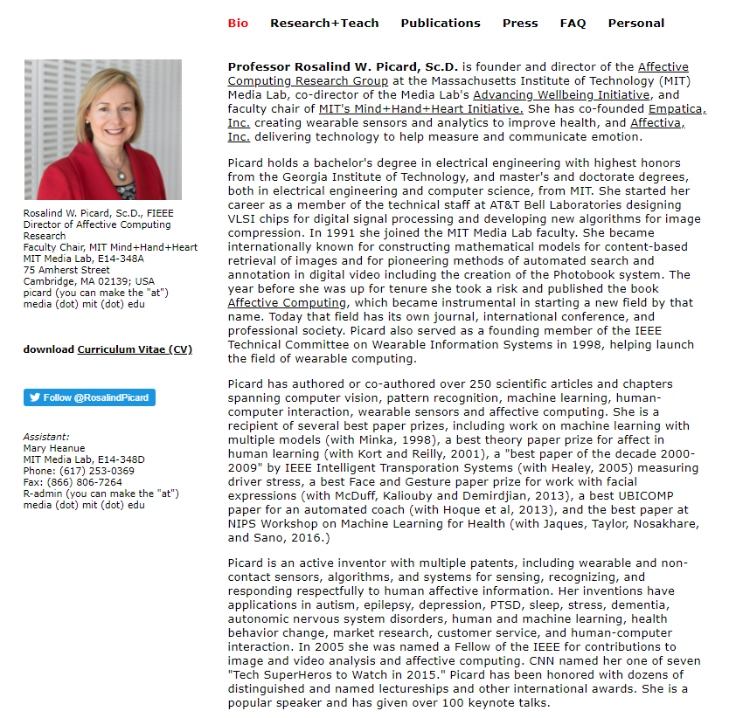

Slide 25

1

Slide 26
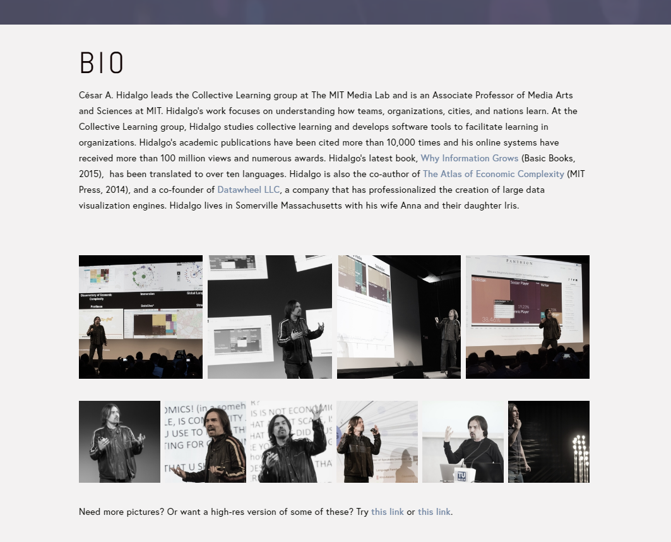
2

Slide 27
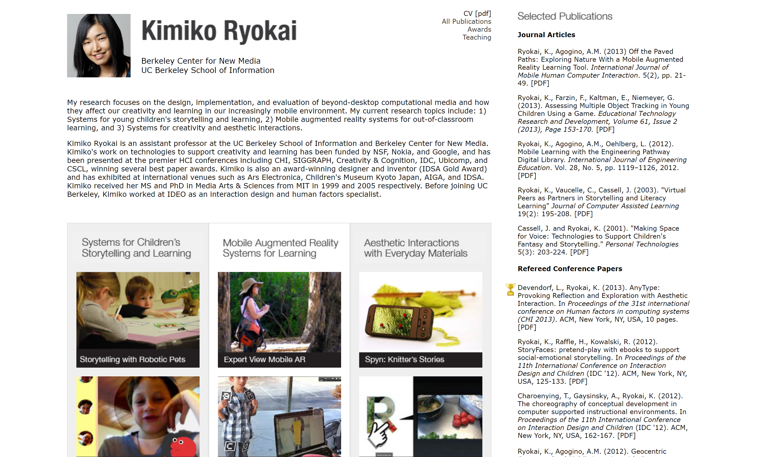

Slide 28


Slide 29
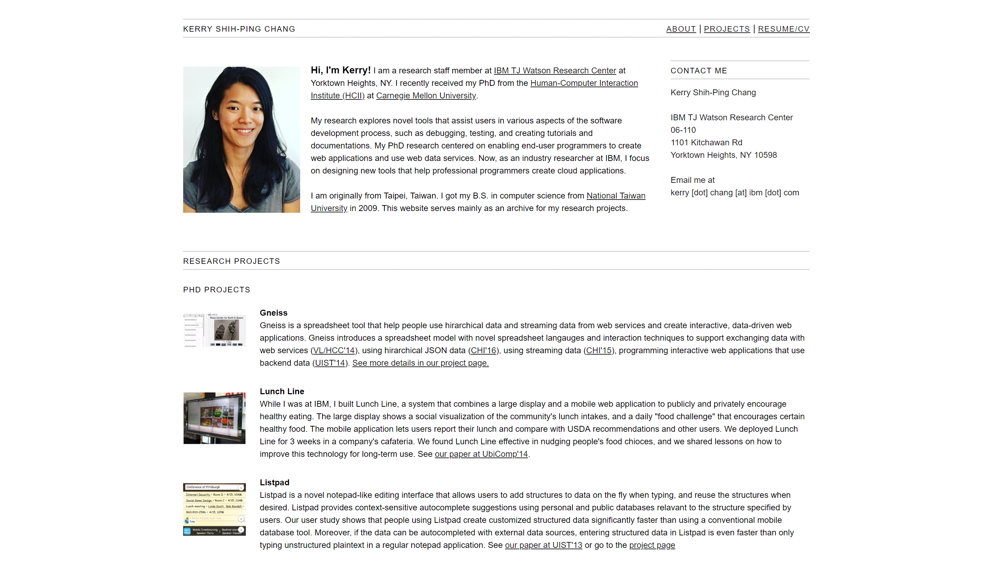

Slide 30
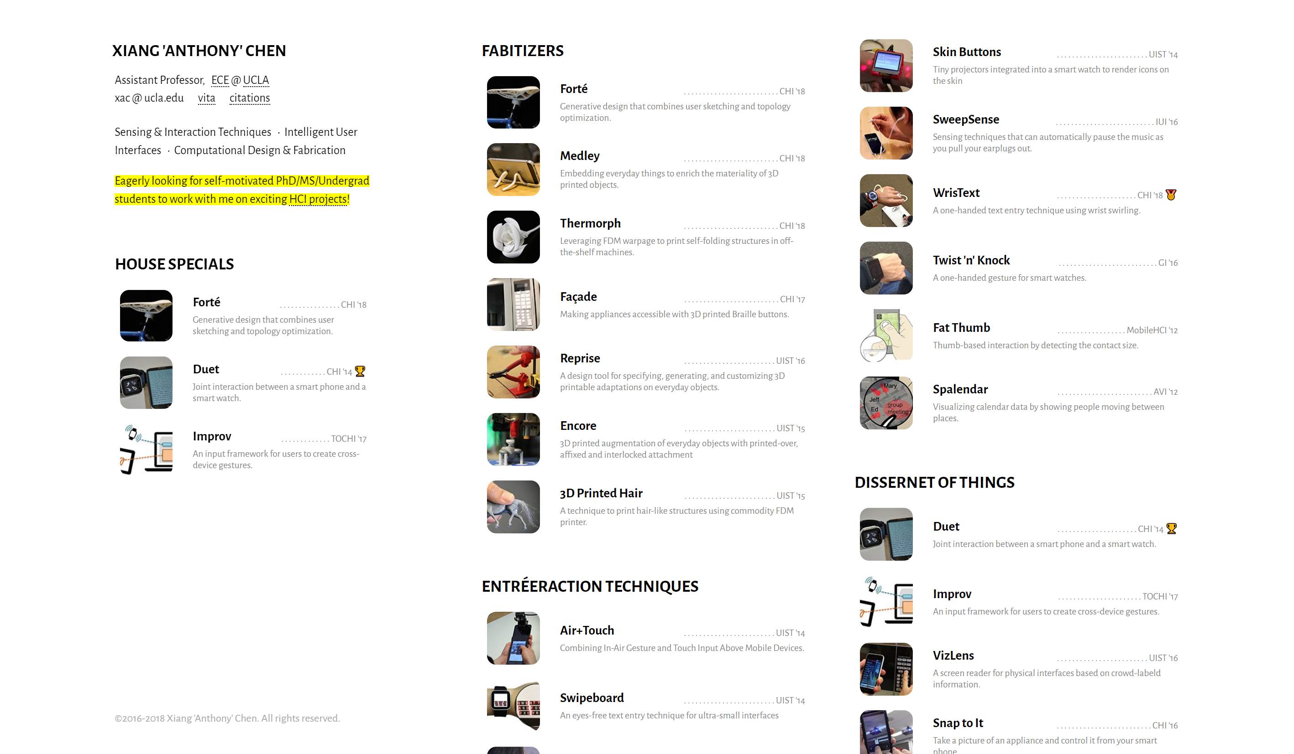

Slide 31

Notes:
http://davidledo.com/index.html

Slide 32

Notes:
www.tichamelody.com

Slide 33


Slide 34

Notes:
And these are animated gifs!

Slide 35
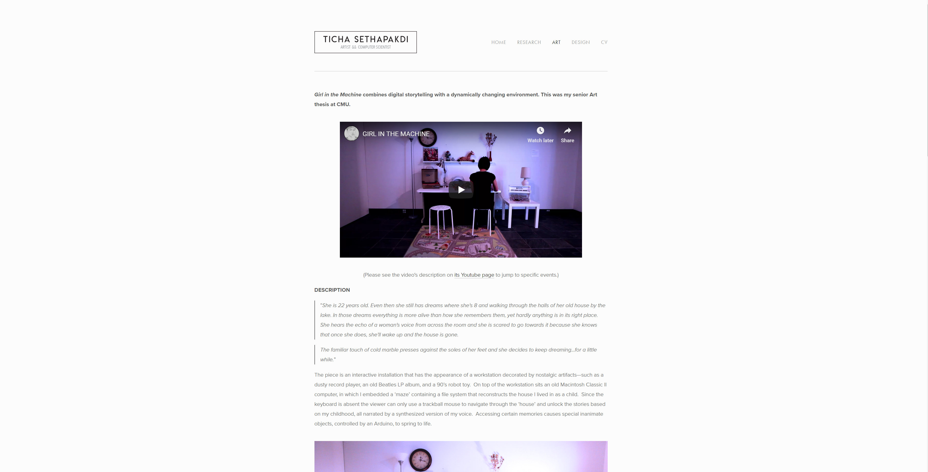

Slide 36


Slide 37
